Slide 1
ERYTHROPOIESIS
Dr.
Hussein AlNaji

Slide 2
ERYTHRON
The erythron is name given to the organ of body, classified as connective tissue, which comprises all the red blood cells plus all the red blood cell producing tissue such as the spleen and bone marrow.

Slide 3
ERYTHROPOIESIS
Primitive erythropoiesis begins and predominates in the yolk sac but also occurs later in the liver. Primitive erythrocytes are large (more than 400 fL in humans), generally nucleated cells with high nuclear:cytoplasmic ratios. Their nuclei have open chromatin and their cytoplasm contains pre­dominantly embryonal hemoglobin (Hb) with a high oxygen affinity.

Slide 4
The common myeloid pro­genitor (CMP) gives rise to the MkEP (megakaryocyte progenitor), which can differentiate into megakaryocyte progenitors (MkPs) or erythroid progenitors (EPs). The production of EPs is stimulated by colony-stimulating factors (SCF), Interleukins (IL-3), GM-CSF, and thrombopoietin (TPO).

Slide 5
Nutrients Needed for Erythropoiesis
In addition to amino acids and essential fatty acids, several metals and vitamins are required for normal erythropoiesis.
The hormone responsible for the regulation of the rate of erythropoiesis is a glycoprotein called erythropoiten, Erythropoiten produced from the kidney, Its affects on RBCs production in 4ways.
More stem cells differentiate to red cell precursors.
Stages of red cell development are speeded up.
Transit time out of bone marrow is reduced.
Immature red cells are released, only occur in response to large doses of erythropoiten.

Slide 6
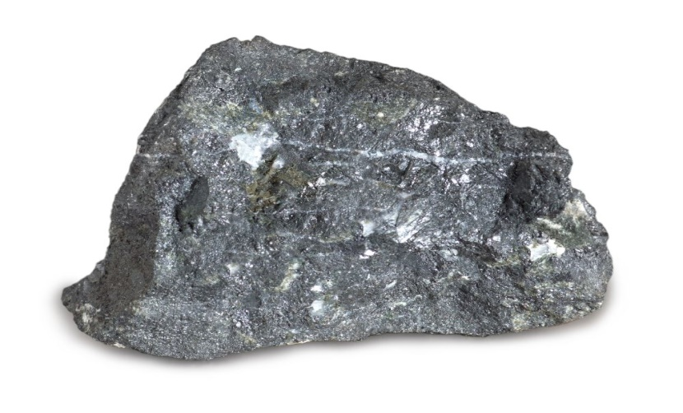
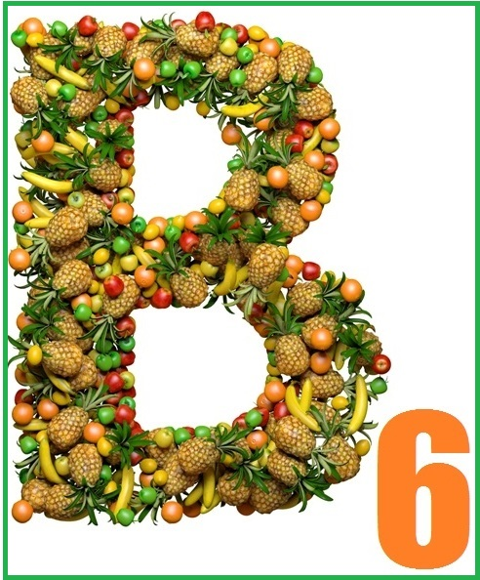
2. Iron is needed for the synthesis of heme, an essential compo­nent of Hb and certain enzymes.
3. Copper, in the form of ceruloplasmin, is important in the release of iron from tissue to plasma for transport to developing erythroid cells.
4. Vitamin B6 (pyridoxine) is needed as a cofactor in the first enzymatic step in heme synthesis.

Slide 7
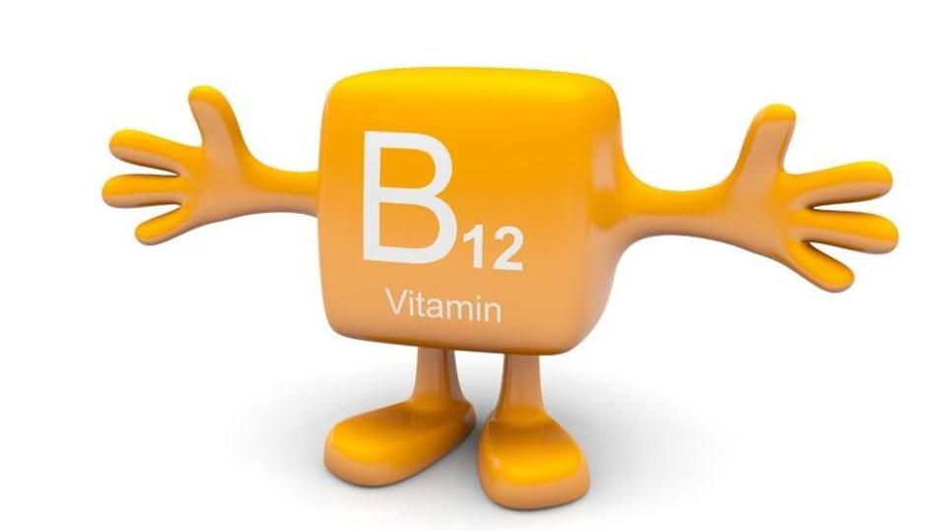
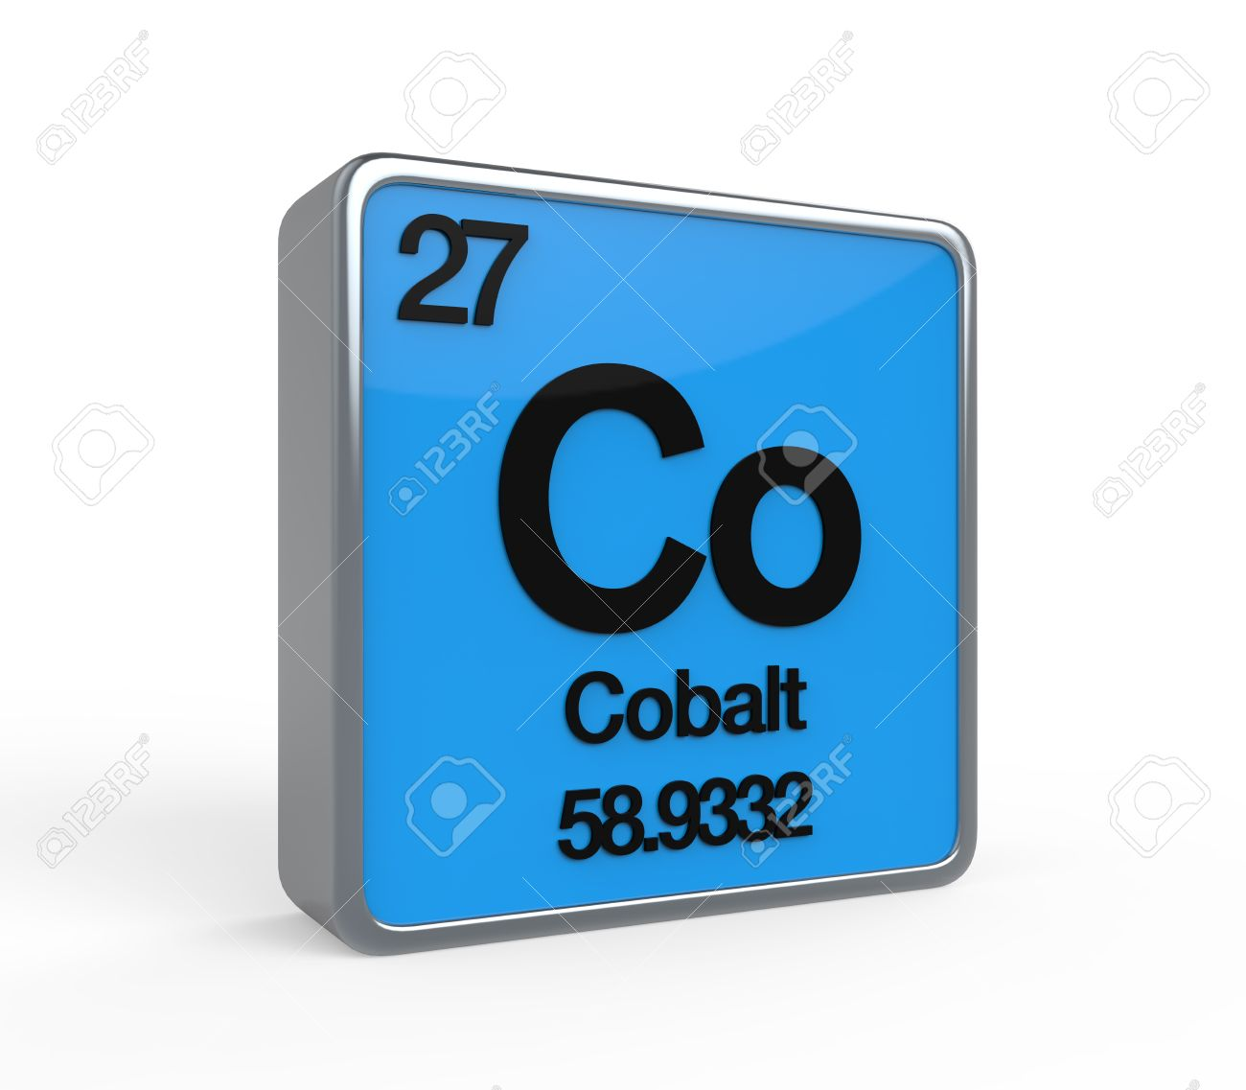
5. Tetrahydrofolic acid, the active form of folic acid (a B vitamin), is needed for the transfer of single carbon-containing molecules in DNA and RNA synthesis.
6. The physiologic mechanism of B12 involvement in erythrocyte production is not well understood, but it is related to folate metabolism.
7. Cobalt is essential for the synthesis of B12 by ruminants.

Slide 8
Maturation of Erythroid Cells
Rubriblasts are continuously generated from progenitor cells in the extravascular space of the bone marrow. The production of a rubriblast initiates a series of approximately four divisions over a period of 3 or 4 days to produce about 16 metarubri­cytes that are no longer capable of division .
These divisions are called maturational divisions because there is a progressive maturation of the nucleus and cytoplasm con­comitant with each division.

Slide 9
As these cells divide and mature some changes occur.
Overall cell size decreases.
Nuclear chromatin condensation increases.
Cytoplasmic basophilia decreases.
Hb progressively accumulates, imparting a red coloration to the cytoplasm.
Reticulocyte maturation begins in the bone marrow and is completed in the peripheral blood and spleen in dogs, cats, and pig.

Slide 10
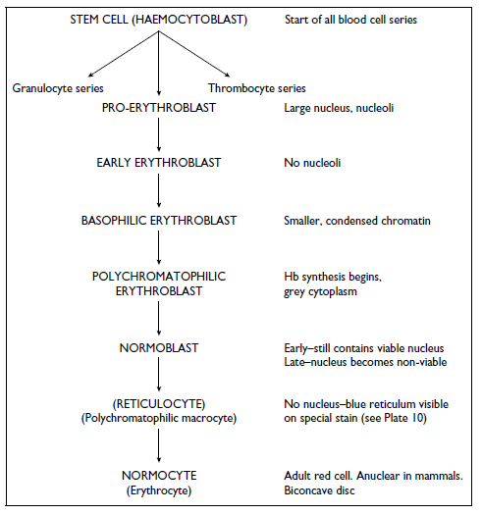

Slide 11
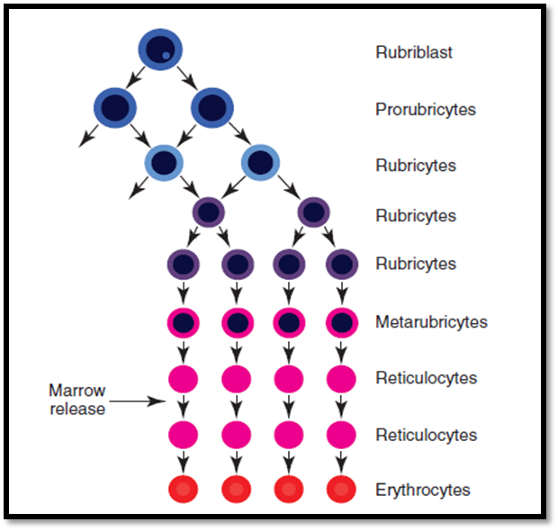

Slide 12
Erythrocyte lifespan
This varies between species from about 2 months in pigs to over 5 months in cattle.
The erythrocytes breakdown occur in three ways
The cell may be fragmented in to pieces small enough for the reticulo-endothelial system to take up.
When the enzymes present in the cell membrane are used up the much more fragile cell breaks up and is phyagocytosed.
The whole cell may be phagocytosed directly.

